Slide 1
A new Business-school ranking by the National accreditation council of business-education (NASDOBR) and Russian association of business-education (RABE)
Dmitry Tolmachev
GSEM UrFU Director, Head of the NASDOBR Working Group on the Development of a National Rating and Ranking System

Slide 2
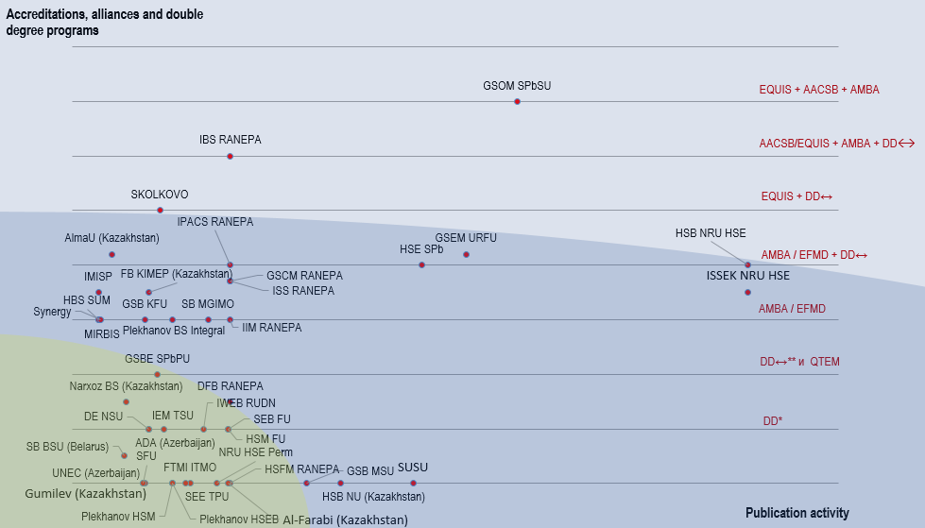
CIS business-schools: global visibility
*DD - double degree programs
**DD ↔ - bilateral student mobility within double degree

Slide 3
Working group – 14 leading business-schools
BUSINESS-SCHOOL | LOCATION
GSEM Ural Federal University | Ekaterinburg
HSB Kazan Federal University | Kazan
School of Business MGIMO | Moscow
IDPO - "Higher Economic School" Saint Petersburg State University of Economics | St.Petersburg
State University of Management | Moscow
Moscow School of Management "SKOLKOVO" | Moscow
SEM Far Eastern Federal University | Vladivostok
MIRBIS | Moscow
ISB Financial University | Moscow
GSOM Saint-Petersburg State University | St.Petersburg
IMISP | Moscow
RUDN | Moscow
Plekhanov School of Business Integral | Moscow
IBDA RANEPA | Moscow
In april 2024 15 leading business schools agreed to launch a new business-education ranking

Slide 4
Existing ratings and rankings
Subject ratings of universities in management and economics
Business schools usually are not shown directly
Business School Ratings/Rankings
Financial Times
Eduniversal
U.S. News Best Business Schools Rankings
Bloomberg BEST B-SCHOOLS
People's Rating of Russian Business Schools
Internationalization Map of Business Schools in Russia and the CIS (AC Expert)

Slide 5
Existing ratings and rankings
Type of indicator | QS |  |  | THE | ARWU | RAEX
 | Economics and Econometrics | Business and Management Studies | Social Policy and Administration | All subject ratings | All subject ratings | Economics, management | Public administration
Surveys | 60% | 80% | 90% | 33% | 0% | 0% | 0%
Data from independent sources | 40% | 20% | 10% | 40% | 100% | 24% | 19%
Data by the universities | 0% | 0% | 0% | 27% | 0% | 76% (from the monitoring) | 81% (from the monitoring)
The varying weight of surveys – from 0% to 80-90%

Slide 6
Other BS ratings and rankings
Eduniversal
https://www.eduniversal-ranking.com/
21 business schools from Russia are included.
The mechanism of the rating:
First, the number of business schools represented by each country is determined based on formal indicators (GDP, population, education indicators, educational traditions).
The leading business schools of the country within this quota are divided into 5 levels (palms) according to their positions in the rankings, accreditations and membership in international associations.
Within each level (palm), schools are ranked based on the results of voting by the management of business schools around the world.

Slide 7
US NEWS & BLOOMBERG
U.S. News Best Business Schools Rankings
Bloomberg BEST B-SCHOOLS
https://www.usnews.com/best-graduate-schools/top-business-schools/mba-rankings
https://www.bloomberg.com/business-schools
Indicator | Weight
Employment rates at graduation | 7%
Employment rates three months after graduation | 13%
Mean starting salary and bonus | 20%
Salary by profession | 10%
Peer assessment score | 12.5%
Recruiter assessment score | 12.5%
Median GMAT and GRE scores | 13%
Median undergraduate GPA | 10%
Acceptance rate | 2%
Indicator | Weight
Compensation - Survey | 17,8125%
Compensation - Data | 19,6875%
Learning - Survey | 26,3%
Networking - Survey | 17,8%
Entrepreneurship - Survey | 11,4%
Diversity – Gender – Data | 3,55%
Diversity – Minority – Data | 3,55%

Slide 8
Financial Times rankings
Title | Note
MBA
Online MBA
EMBA
Executive Education Custom | Mainly based on survey data
Executive Education Open | Mainly based on survey data
Masters in Finance pre-experience
Masters in Finance post-experience
Masters in Management
European Business School Rankings | Composite: MBA + EMBA + Masters in Management + Executive Education Custom + Executive Education Open

Slide 9
MBA Financial Times Ranking
Group of indicators | Indicator | Weight
Surveys on achievement of learning objectives | Weighted salary | 16%
 | Salary increase | 16%
 | Value for money rank | 5%
 | Career progress rank | 3%
 | Aims achieved | 4%
Employment and direct assistance from the business school in it | Alumni network rank | 4%
 | Careers service rank | 3%
 | Employed at three months | 2%
 | Sector diversity rank | 3%
Gender indicators | Female faculty | 3%
 | Female students | 3%
 | Women on board | 1%
Internationalization – staff and students | International faculty | 3%
 | International students | 3%
 | International board | 1%
Internationalization - mobility | International mobility rank | 5%
 | International course experience rank | 3%
Science | Faculty with doctorates | 5%
 | FT research rank | 10%
ESG | Carbon footprint rank | 4%
 | ESG and net zero teaching rank | 3%

Slide 10
RUSSIAN BS ratings and rankings
People's rating of Russian business schools
https://www.mba.su/rejting_biznes_shkol_2023_mba_su/
Survey
Indicator | Weight
Income growth assessment | 33,33%
Career growth assessment | 33,33%
Networking assessment | 11%
Personal and professional development assessment | 22,33%
928 voters from 39 schools

Slide 11
RUSSIAN BS ratings and rankings
Internationalization Map of Business Schools in Russia and the CIS (AC Expert)
https://expert-ural.com/analytics/ratings/karta-internacionalizacii-biznes-shkol-rossii-i-sng--2023.html
Indicators | Data
Schools with "first level" accreditations | EFMD, AACSB and AMBA websites
Positions in QS and THE subject ratings in management | QS and THE websites
Publication activity in economics and management | SciVal, ABDC websites
Business schools by the number of partnerships with foreign universities that have "first level" accreditations | Data by BS + EFMD, AACSB and AMBA websites
Business schools implementing double degree programs with foreign universities | Data by BS + EFMD, AACSB and AMBA websites
Number of courses in management, economics and data analysis posted on the "Open Education" platform | https://openedu.ru/

Slide 12
NEW RANKING: Target audience
Applicants with work experience (MBA, EMBA and DBA programs, individual master's programs) and without work experience (bachelor's programs and other master's programs)
Business schools in Russia and other countries
rating/ranking criteria should motivate them to develop various aspects of their activities, which will contribute to the overall development of business education in Russia and partner countries.
Possibility of comparing different business schools, including foreign ones, for the purpose of developing partnerships
Companies, public sector
Possibility of comparing different business schools for the purpose of developing partnerships

Slide 13
Goals of the new rating/ranking
Providing applicants and partner companies with reliable information about the quality of educational programs and the reputation of business schools
Encouraging business schools to improve the quality of educational programs
Developing cooperation between Russian business schools, establishing partnerships with foreign business schools
Providing a reliable platform for benchmarking business schools

Slide 14
Evaluation: objects, depth etc
The main questions to the working group were:
To develop a rating, ranking, or both?
To evaluate programs, business schools, or both.
Preliminary decision:
Russian and International Business schools rankings (ranking by certain important criteria, but not intended to be a comprehensive assessment of School)
MBA programs by Russian and International Business schools rating
(Evaluation of the most important criteria that reflect the quality of MBA program, however not as comprehensive compared to accreditation)
and
Entry criteria for both program ranking and school ranking
Accreditation of NASDOBR
and/or
First level accreditation (AACSB/EQUIS/EFMD/AMBA) as of the end of 2021.

Slide 15
Possible groups of indicators
Group |  | Analogue | Possible indicators
Achieving learning goals, salary growth and career advancement |  | FT, PRRBS, US News, Bloomberg | Numerical assessment of satisfaction with such parameters as: achieved goals; income and income growth; subsequent employment and/or career growth.
Internationalization |  | FT, THE, ARWU, IMBS | share of international faculty share of international students number of partnerships and double degree programs international mobility geographical diversity of international mobility share of business school papers written in international collaboration
Scientific achievements |  | FT, QS, THE, ARWU, RAEX, IMBS | number of publications in leading international journals weighted citation of publications in leading international journals
Sustainable development |  | FT | share of courses on ESG topics; involvement in promoting ESG topics in the region and the country
Diversity |  | FT, Bloomberg | diversity of industries in which graduates work diversity of industries in which students work (for programs for people with work experience) gender diversity of students geographical diversity of students (by region and country) ethnic diversity of students

Slide 16
The cycle: start in 2025
№ | Stage | Duration | Comment
1 | Development of methodology | 1 month
2 | Requesting data from business schools | 1-2 months | Entry criteria is accreditation of NASDOBR and/or first level accreditation (AACSB/EQUIS/EFMD/AMBA) as of the end of 2021.
3 | Conducting a survey | 1-2 months | If conducting a survey does not require interaction with business schools (for example, to get contacts of graduates), then conducting a survey is possible in parallel with Stage 1
4 | Processing results | 1 month
5 | Presentation of results and preparation of a release | 2 weeks
 | Total | 4-6 months

Slide 17
Thank you for the attention

